Slide 1

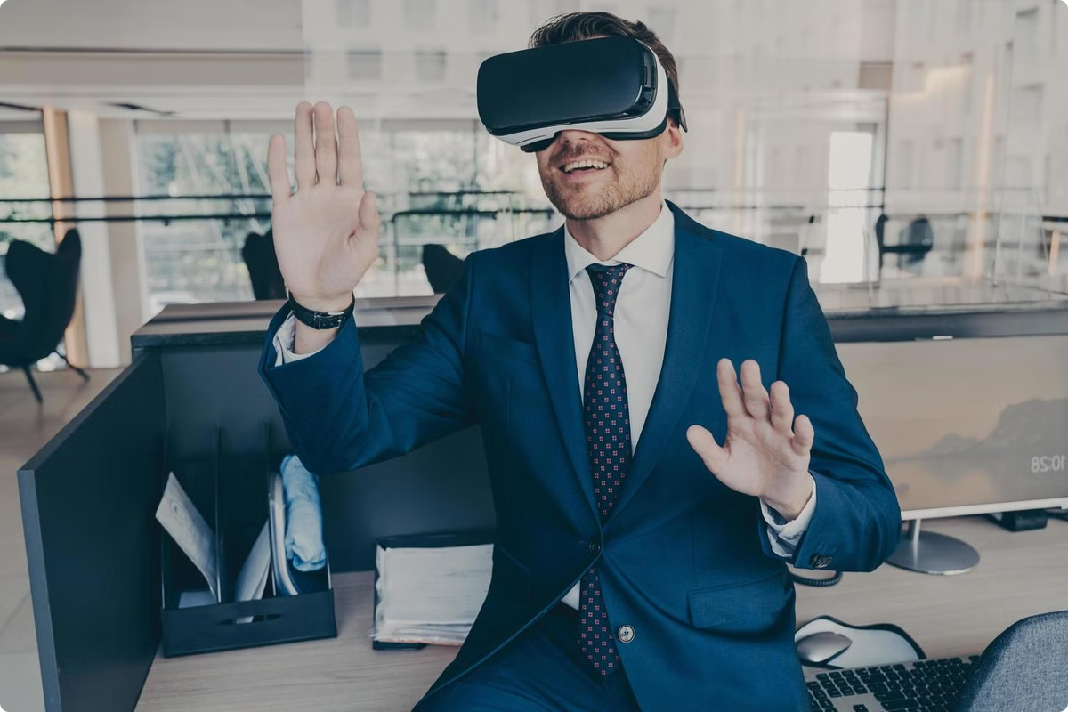
Augmented Reality: Redefining the Future of Interactions
Augmented reality (AR) overlays digital information onto the real world. This innovative technology is transforming how we interact with our surroundings. It blends the physical and digital seamlessly.

Slide 2


What is Augmented Reality?
Definition
Key Features
Examples
AR enhances our perception of reality by adding computer-generated perceptual information.
It involves real-time interaction and registration in 3D space. It's often achieved through smartphones or AR glasses.
Think Pokémon Go, Snapchat filters, or IKEA Place app.

Slide 3
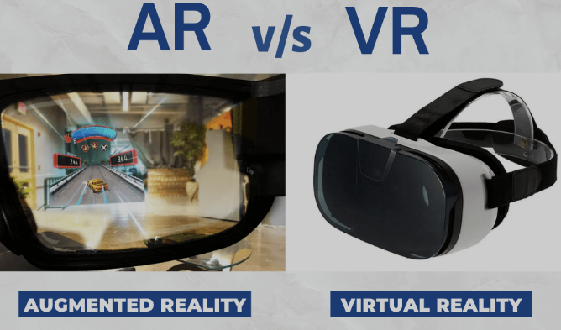
Augmented Reality (AR) VS Virtual Reality (VR)
Augmented reality (AR) overlays digital information onto the real world. Virtual reality (VR) creates entirely immersive digital environments. They offer distinct user experiences and applications.

Slide 4

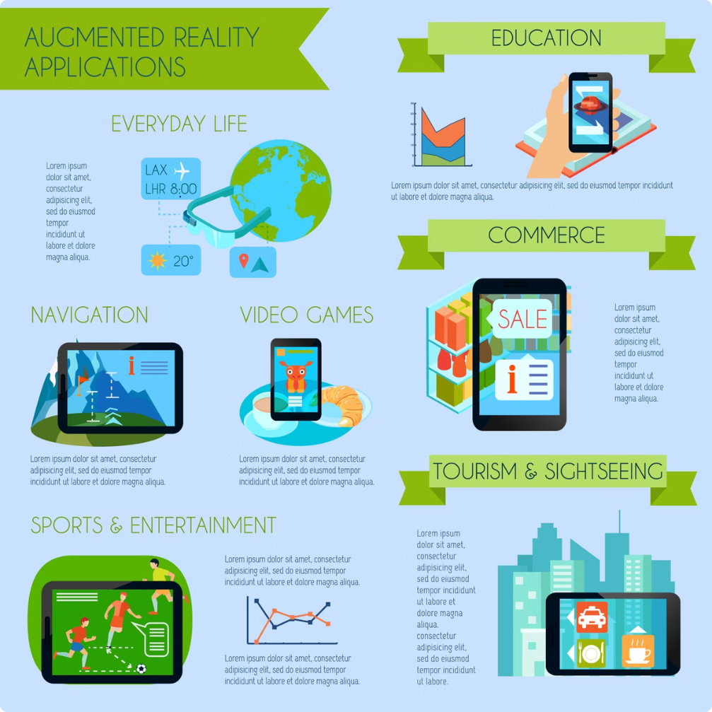
Advantages of Augmented Reality
1
Enhanced Engagement
2
Improved Information Access
AR creates interactive and immersive experiences. Users actively participate rather than passively observe.
It provides immediate access to relevant data. This improves decision-making and problem-solving.
3
Cost-Effectiveness
4
New Possibilities
AR can reduce costs in training, design, and other sectors.
It opens up new avenues for creativity and innovation across various fields.

Slide 5
Applications of Augmented Reality
Gaming
Retail
Healthcare
AR games like Pokémon Go revolutionized mobile gaming.
Virtual try-ons and interactive product displays enhance shopping.
Surgical planning, medical training, and patient care benefit greatly.

Slide 6
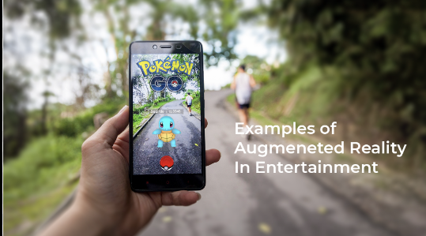
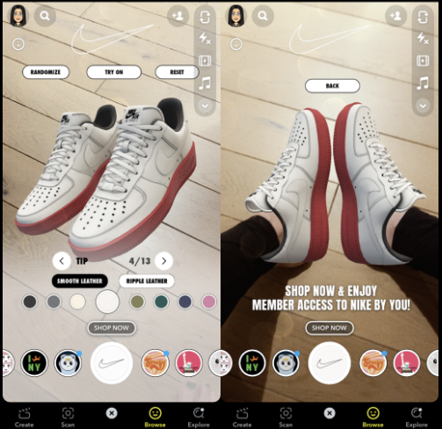
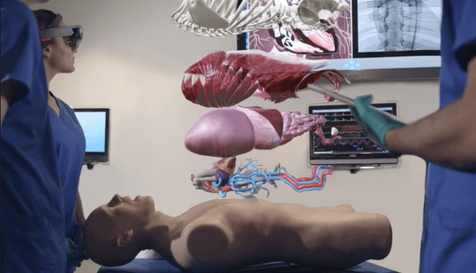

Slide 7

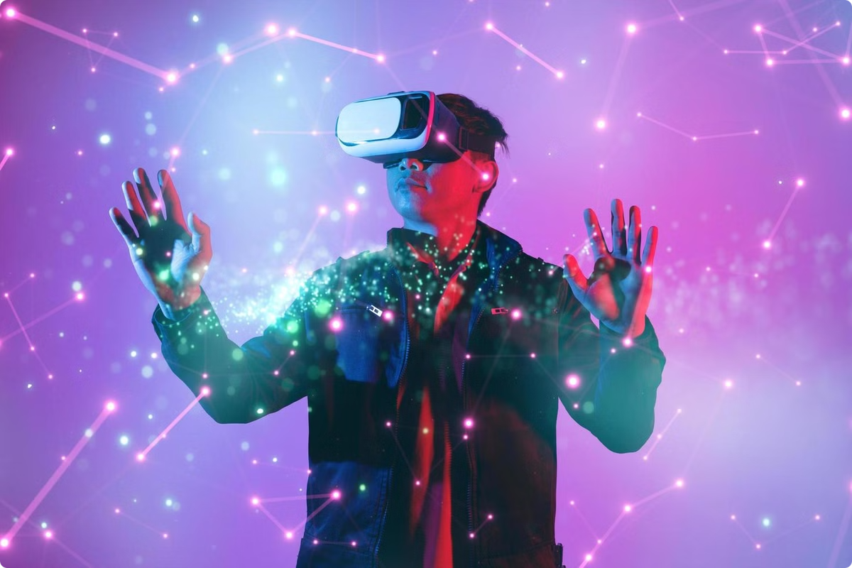



Immersive Gaming and Entertainment
Enhanced Realism
AR games blend virtual objects with the real world.
Interactive Gameplay
Players physically engage with their environment and virtual elements.
New Experiences
AR offers unique and immersive gaming experiences.

Slide 8


Transforming Retail and E-commerce
1
Virtual Try-Ons
Customers virtually try on clothes, makeup, or accessories.
2
Interactive Catalogs
AR apps display 3D models of products, enhancing engagement.
3
Enhanced Store Experiences
AR enhances physical stores with interactive displays and information.

Slide 9

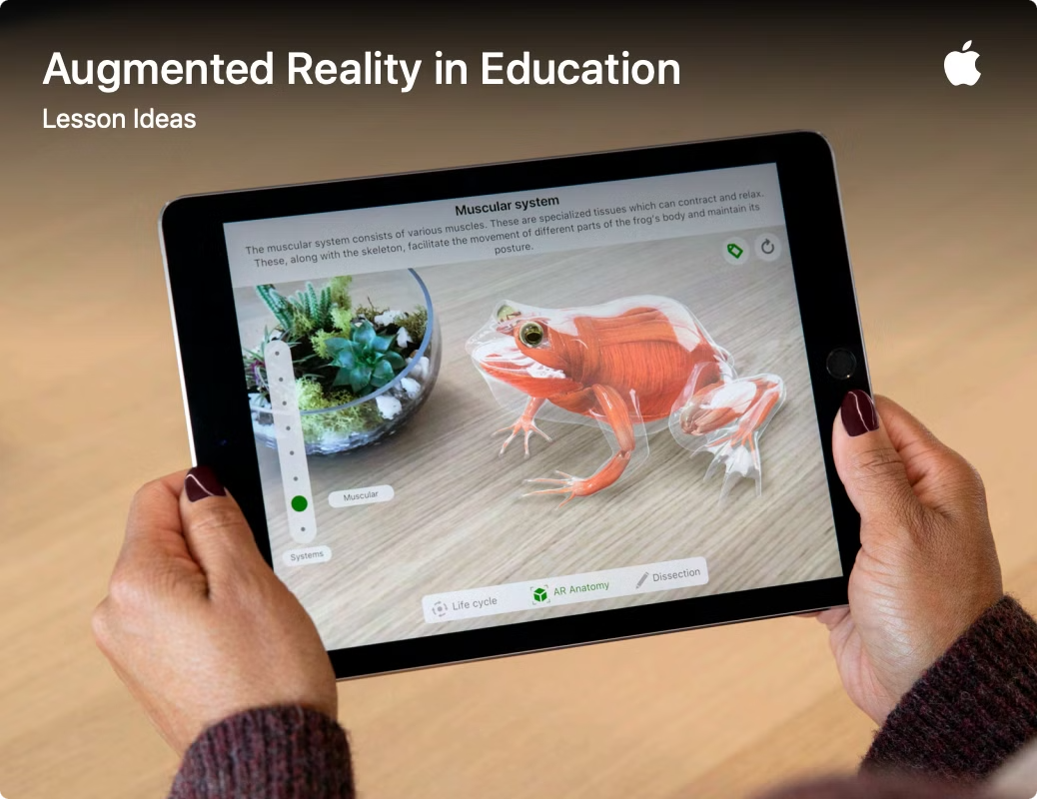



Revolutionizing Education and Training
Interactive Learning
AR makes learning more engaging and fun.
Virtual Field Trips
Students can explore places without leaving the classroom.
Hands-on Training
AR provides realistic simulations for training purposes.

Slide 10


Empowering the Healthcare Sector
Surgical Planning
Improved Accuracy
Medical Training
Realistic Simulations
Patient Care
Enhanced Engagement

Slide 11

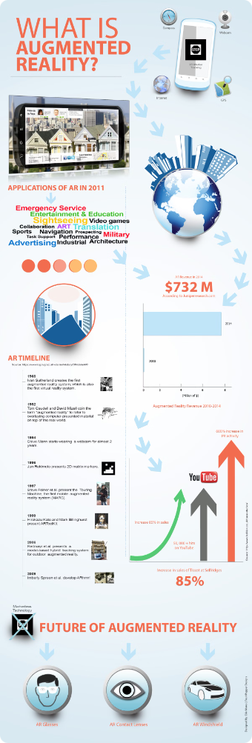
Challenges and Limitations of Augmented Reality
1
High Costs
2
Technical Limitations
Developing and implementing AR technologies can be expensive.
AR technology is still developing, with limitations in accuracy and processing speed.
3
Privacy Concerns
Data privacy and security are important concerns related to AR.

Slide 12
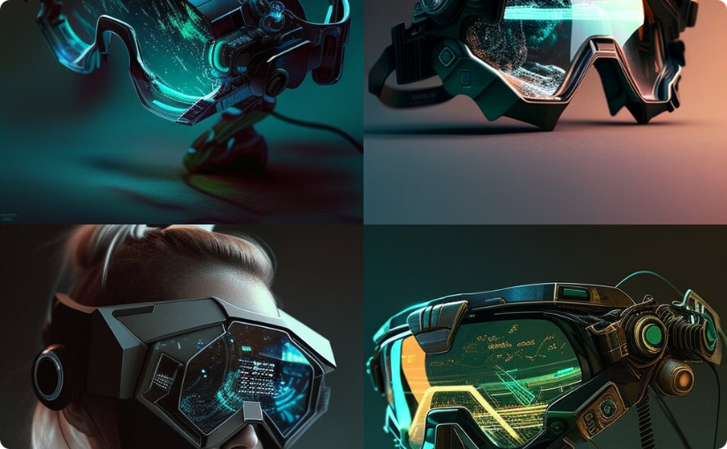

The Future of Augmented Reality
Improved Hardware
Wider Adoption
More comfortable and powerful AR devices will emerge.
AR will become more integrated into daily activities.

